Slide 1
Backorder Prediction

Slide 2
Objective:
The objective of this project is to develop a predictive model using machine learning techniques to accurately forecast backorders in an ecommerce domain. By leveraging historical data from inventories, supply chain, and sales, the model aims to classify products as either going into backorder or not, enabling streamlined planning and mitigating the strain on production, logistics, and transportation.
Benefits:
Improved Planning: By accurately predicting backorders, businesses can plan their production, logistics, and transportation more efficiently. They can proactively address potential stockouts and arrange for timely replenishment, reducing the impact on customer satisfaction and revenue loss.
Enhanced Customer Experience: Anticipating backorders allows businesses to communicate accurate delivery timelines to customers, managing their expectations effectively. This helps in building trust and loyalty among customers, leading to an improved overall shopping experience.
Optimal Resource Allocation: With insights from the predictive model, businesses can allocate their resources more effectively. They can optimize inventory levels, streamline procurement processes, and allocate warehouse space efficiently, reducing costs and improving operational efficiency.
Minimized Stockouts: By identifying products that are likely to go into backorder, businesses can take preventive measures such as adjusting reorder points, implementing safety stock policies, or finding alternative suppliers to minimize stockouts and ensure continuous availability of popular products.
Data-Driven Decision Making: Leveraging historical data and machine learning, the predictive model enables data-driven decision making. Businesses can gain valuable insights into factors contributing to backorders, identify patterns, and make informed decisions to address underlying issues and improve overall supply chain management.

Slide 3
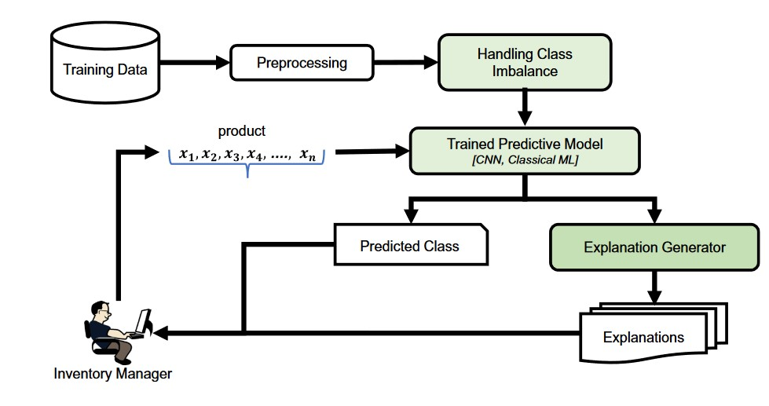
Model training/validation workflow

Slide 4
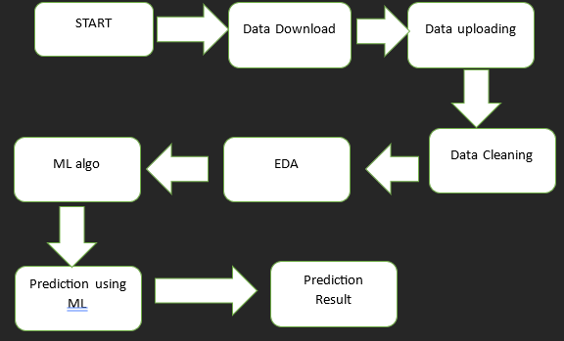
Architecture

Slide 5
Model training
RandomForestClassifier: The model achieved an AUC score of 0.5420778807268269. It was trained on oversampled data using the SMOTE technique.
AdaBoostClassifier: The model was trained with a learning rate of 0.1 and achieved an AUC score of 0.8249221469625202.
XGBClassifier (Gradient Boosting): The model was tested with different learning rates and tree depths, resulting in various AUC scores ranging from 0.7571819702628692 to 0.806347139930128.
Sequential Neural Network (Keras): The model architecture includes three dense layers with dropout. After training for 10 epochs, it achieved an accuracy of around 50% on the test set, indicating poor performance.
Test set performance: The test set confusion matrix shows a very imbalanced distribution of predictions, with most instances being classified as the majority class (0) and very few as the minority class (1). The AUC score is very low at 0.500036536099406, indicating poor predictive performance.

Slide 6
Prediction
Model Selection: Multiple machine learning models were evaluated, including RandomForestClassifier, AdaBoostClassifier, XGBClassifier, and others, to predict backorders in the ecommerce domain.
Evaluation Metrics: The performance of each model was assessed using AUC (Area Under the Curve) score, which measures the model's ability to distinguish between positive and negative instances in the predictions. A higher AUC score indicates better predictive performance.
Data Oversampling: The SMOTE (Synthetic Minority Over-sampling Technique) algorithm was employed to address the class imbalance issue by oversampling the minority class (backorders). This technique helps to improve the model's ability to predict the minority class accurately.
Ensemble Methods: AdaBoostClassifier and XGBClassifier utilized ensemble methods, such as boosting, to improve prediction accuracy. These methods combine multiple weak classifiers to create a strong ensemble model, capturing complex relationships in the data.
Neural Network: A sequential neural network model was implemented using the Keras framework. However, the model's performance on the test set was poor, suggesting a need for further optimization and tuning.
Performance Analysis: The test set performance was evaluated using a confusion matrix, which showed imbalanced predictions with a majority of instances classified as the majority class (0) and a very small number classified as the minority class (1).
Room for Improvement: The overall results indicate a need for further model refinement and feature engineering to improve predictive accuracy and address the challenge of predicting the minority class accurately.

Slide 7
Q & A:
Q1)Data Source?
Dataset: https://github.com/rodrigosantis1/backorder_prediction/blob/master/dataset.rar
Q 2) What was the type of data?
Numerical Columns:
national_inv: Represents the current inventory level of a product.
lead_time: Indicates the time taken for replenishment or delivery of the product.
in_transit_qty: Refers to the quantity of the product currently in transit.
forecast_3_month, forecast_6_month, forecast_9_month: Represent the forecasted demand for the product over different time periods.
sales_1_month, sales_3_month, sales_6_month, sales_9_month: Denote the actual sales quantities over different time periods.
min_bank: Indicates the minimum amount of stock required for a product.
pieces_past_due: Represents the number of pieces that are past their due date.
perf_6_month_avg, perf_12_month_avg: Indicate the performance (availability) of the product over different time periods.
local_bo_qty: Represents the quantity of the product currently on backorder.
Categorical Columns:
sku: Refers to the stock keeping unit or identifier for the product.
potential_issue, deck_risk, oe_constraint, ppap_risk, stop_auto_buy, rev_stop: These columns contain categorical values indicating the presence or absence of certain issues or risks related to the product.
went_on_backorder: This column contains the target variable, indicating whether the product went on backorder (Yes) or not (No).

Slide 8
Q & A:
Q 3) What’s the complete flow you followed in this Project?
Data Exploration
Data Cleaning
Dataset
Model
Building
Feature
Engineering
Make Prediction
Prediction Result

Slide 9
Q 5) How logs are managed?
We are using different logs as per the steps that we follow in validation and
modeling like File validation log , Data Insertion ,Model Training log , prediction log
etc.
Q 6) What techniques were you using for data pre-processing?
Removing unwanted attributes
Visualizing relation of independent variables with each other and output variables
Checking and changing Distribution of continuous values
Removing outliers
Cleaning data and imputing if null values are present.
Converting categorical data into numeric values.
Scaling the data

Slide 10
Q 7) How training was done or what models were used?
• RandomForestClassifier: This is a popular ensemble learning method that constructs a multitude of decision trees and outputs the class that is the mode of the classes predicted by individual trees.
• AdaBoostClassifier: This is an ensemble method that combines multiple weak classifiers and assigns weights to them based on their performance. It iteratively trains models to correct the mistakes made by previous models, thus creating a strong ensemble model.
• XGBClassifier: This refers to the XGBoost (Extreme Gradient Boosting) algorithm, which is a powerful gradient boosting framework. It sequentially builds weak decision tree models and combines their predictions to form a final prediction.
• DecisionTreeClassifier: This is a basic decision tree model that splits the data based on the features to make predictions.
• KNeighborsClassifier: This is a non-parametric classification algorithm that assigns a class label based on the majority class of its k nearest neighbors.
• LogisticRegression: This is a popular linear classification algorithm that models the probability of a binary outcome using logistic functions.
• StackingClassifier: This is an ensemble method that combines multiple classification models by training a meta-classifier on their predictions

Slide 11
Q 8) How Prediction was done?
Once the models are trained on the training data, they are ready to make predictions on new, unseen data.
To make predictions, the trained models are applied to the test dataset or any new dataset that needs backorder prediction.
For each model, the predict() function or method is used to obtain the predicted labels or classes for the input data.
The predicted labels or classes represent the model's prediction for whether a product will go on backorder (Yes) or not (No).
In some cases, additional evaluation metrics may be computed to assess the performance of the models. Examples include accuracy, precision, recall, F1-score, and area under the receiver operating characteristic (ROC) curve (AUC).
The predicted labels or classes, along with the actual labels or classes from the test dataset, can be used to evaluate the performance of the models and calculate metrics such as accuracy, precision, recall, and AUC.

Slide 12
Thankyou!

